Slide 1
ATM Machine: EDA Project

Slide 2
Members
01
04
02
03
Abdallah Ahmed
Youssef Mohamed
Saleh Ahmed
05
Ahmed Hossam
Mohamed Esmat
06
Zeynat Haytham
07
Shahd Ashraf

Slide 3
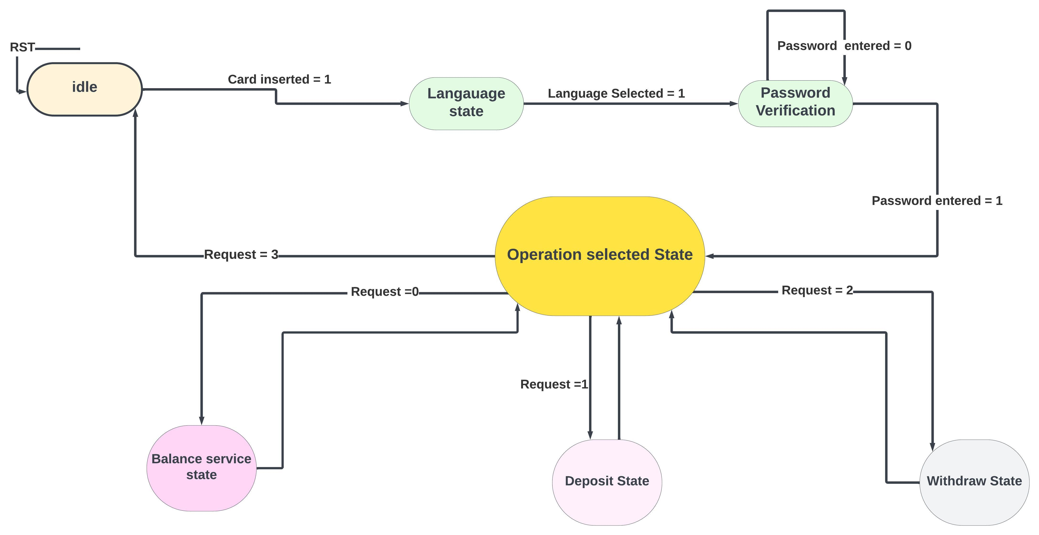
FSM Design

Slide 4
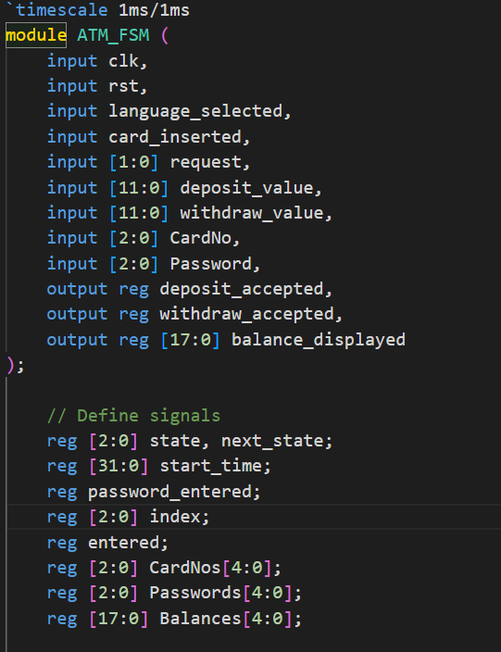
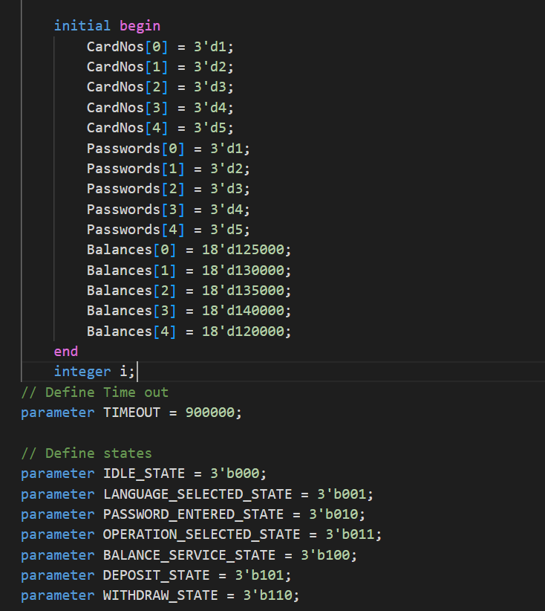
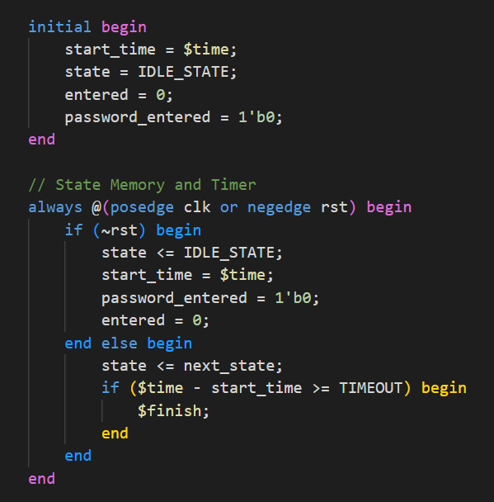
RTL

Slide 5
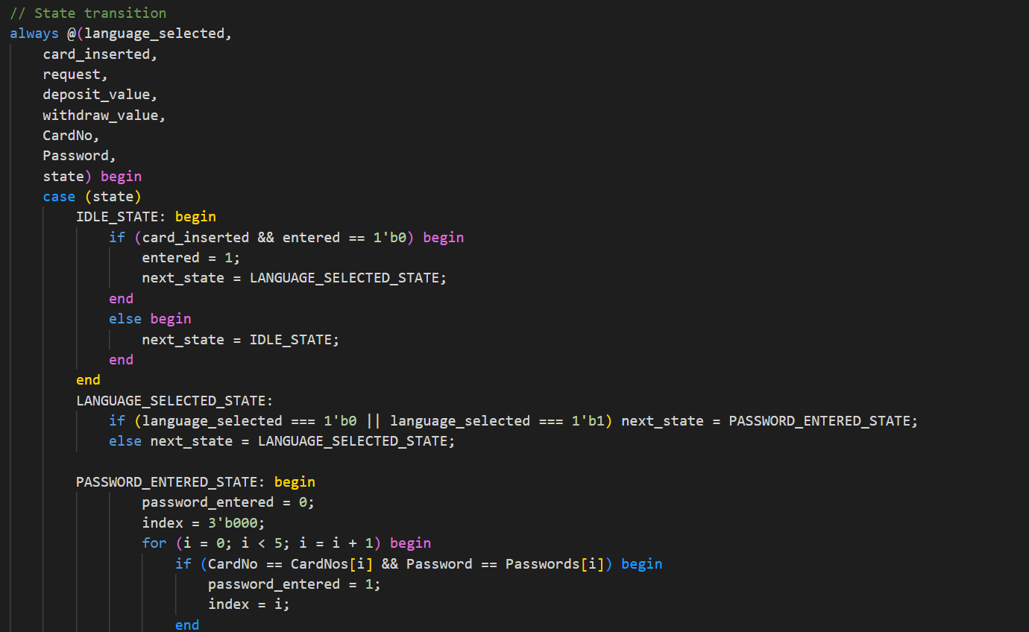
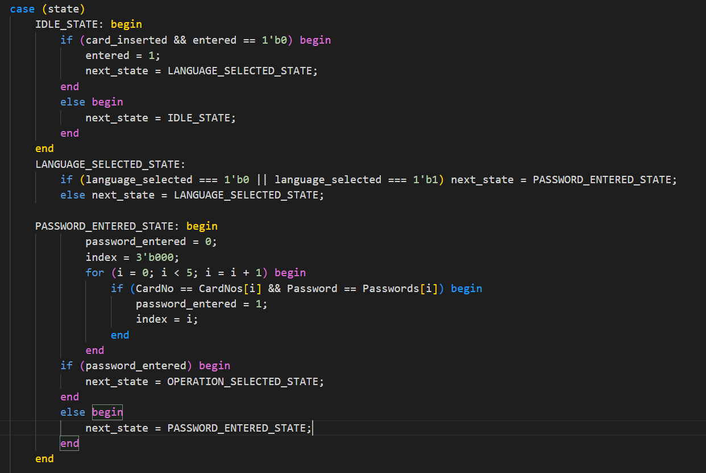
RTL

Slide 6
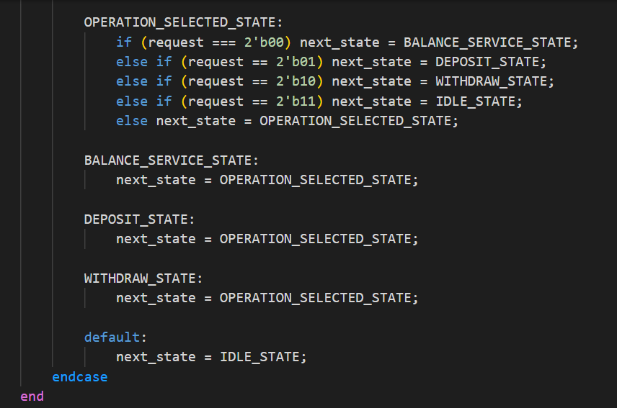
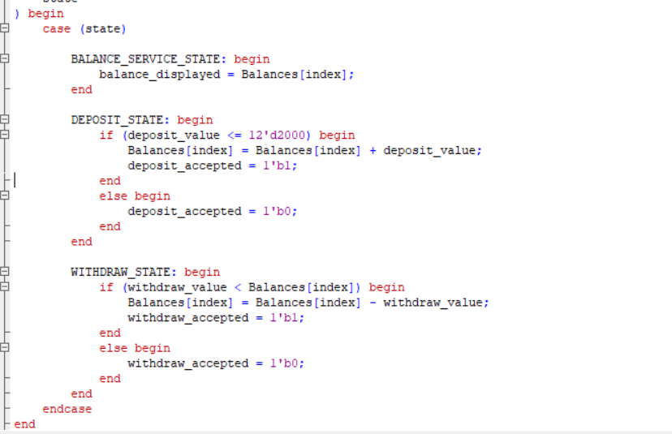
RTL

Slide 7
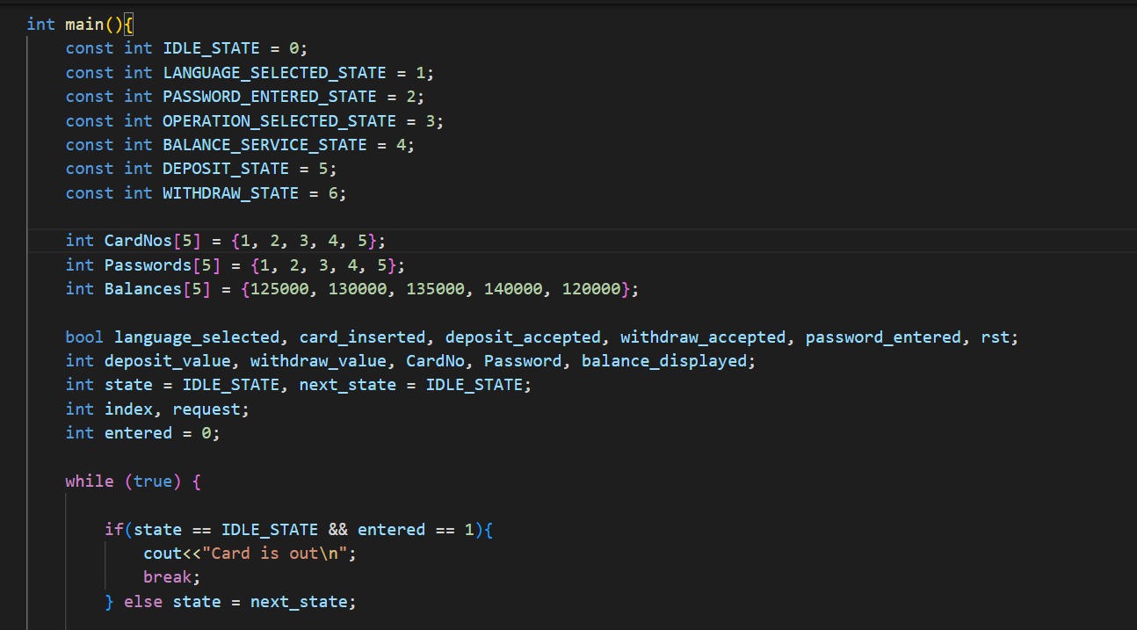
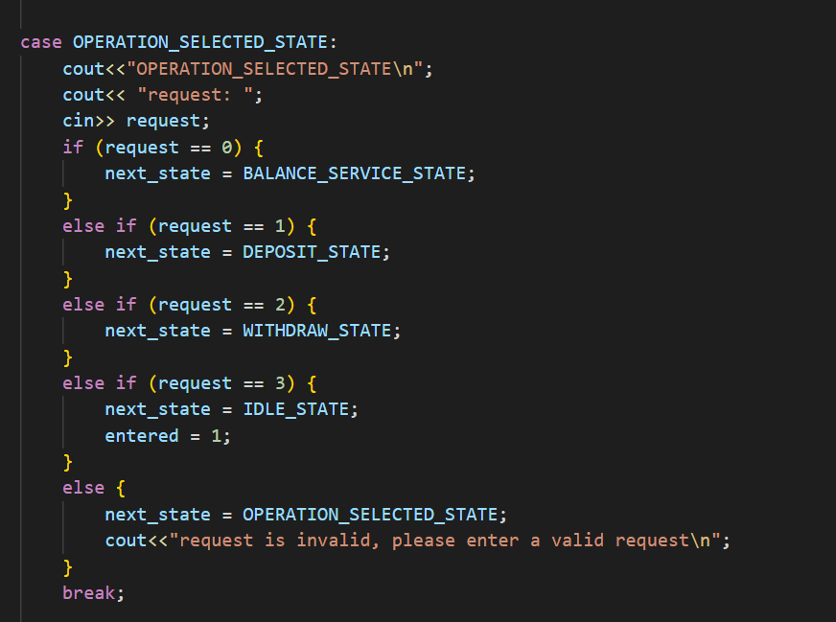
High Level Model

Slide 8
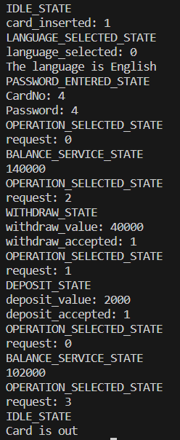
High Level Model

Slide 9
Verification Plan/Techniques
Methods
1.Simulation-based testing using Verilog.
2.Randomized testing for various inputs.
3.Assertions for checking expected conditions.
Techniques:
• Cover different scenarios: normal transactions, multiple card scenarios, unusual transactions, incorrect password handling, simultaneous requests, and random transactions.
• Test the same scenarios in the Verilog test bench and then in Visual Studio using C++ and verify the results are the same (Self Checking Test)

Slide 10
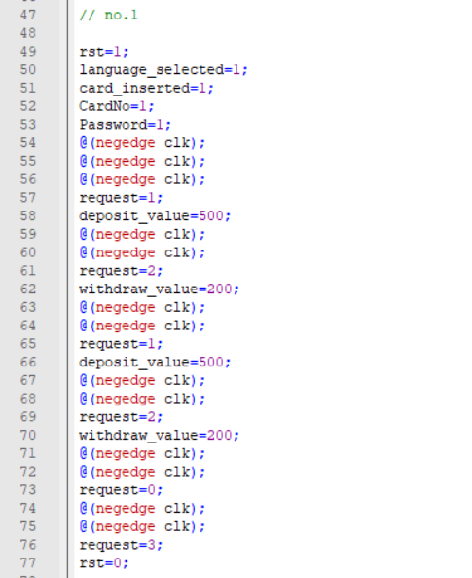
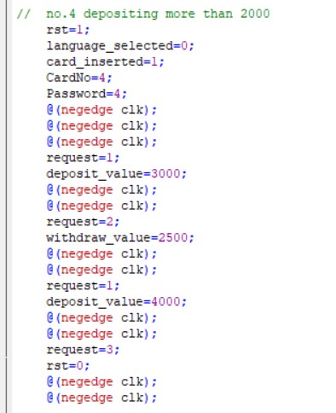
Directed Testing

Slide 11
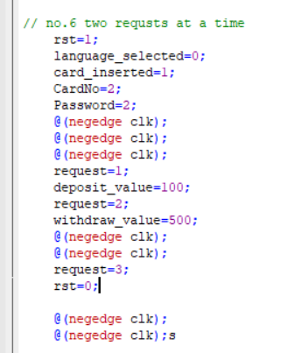
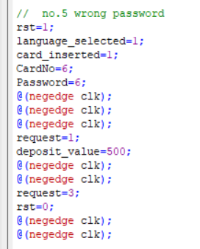
Directed Testing

Slide 12
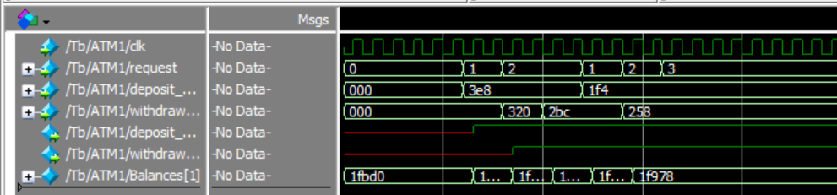
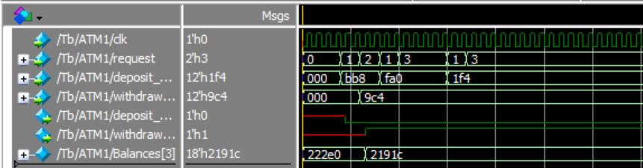
Verification Results
Directed Case:

Slide 13
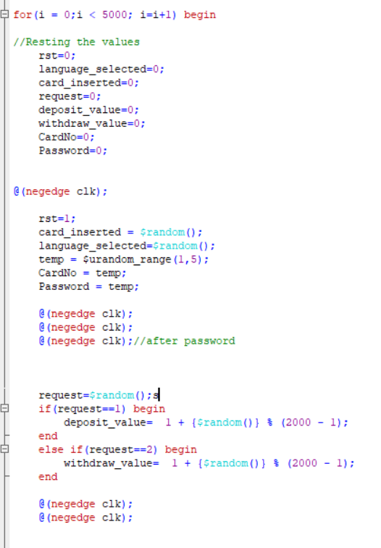
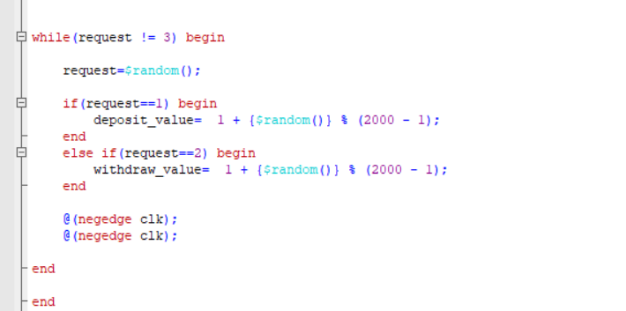
Randomized Testing

Slide 14
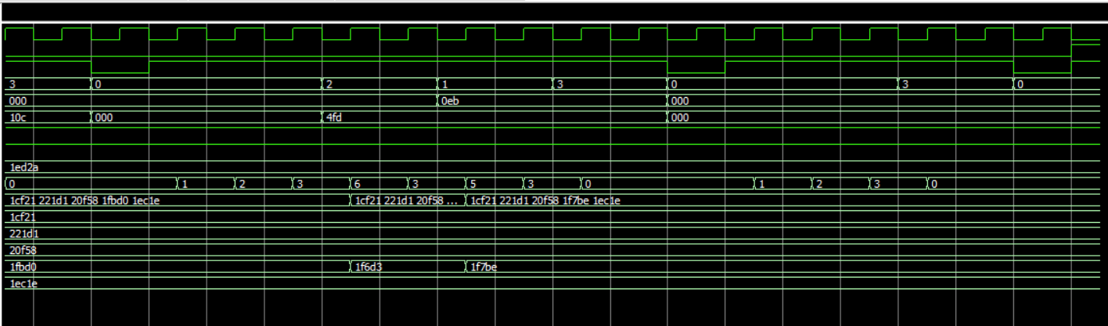
Verification Results
Random Case:

Slide 15
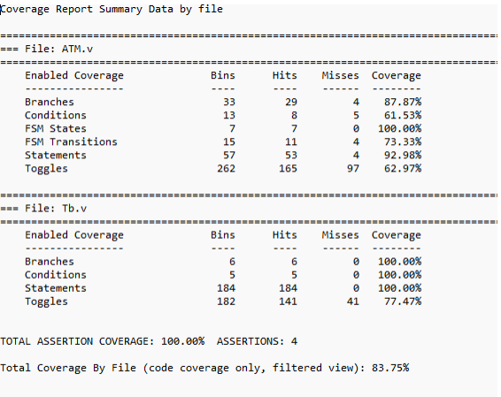
Coverage Report

Slide 16
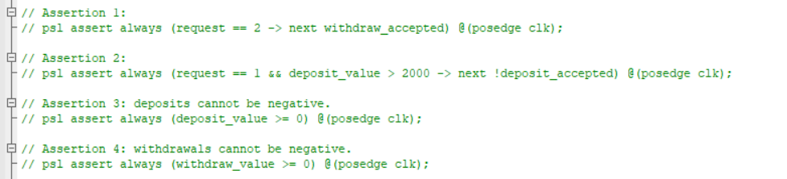
Assertions

Slide 17
CONCLUSION
THANKS!

